Slide 1



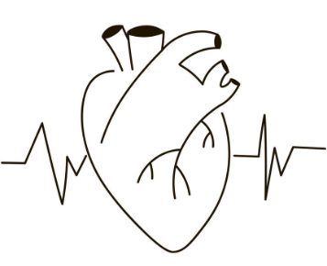


Slide 2
MOTIVATION
Cardiovascular diseases remain a significant global health concern, necessitating accurate and efficient methods for early detection and diagnosis.
In this project, we aim to design a robust predictive model for heart disease by employing various classification algorithms.

Slide 3
HYPOTHESIS
A multivariate analysis of the dataset, incorporating various attributes will reveal a combination of these attributes that serves as a robust predictor for the presence or absence of heart disease in the studied population.

Slide 4
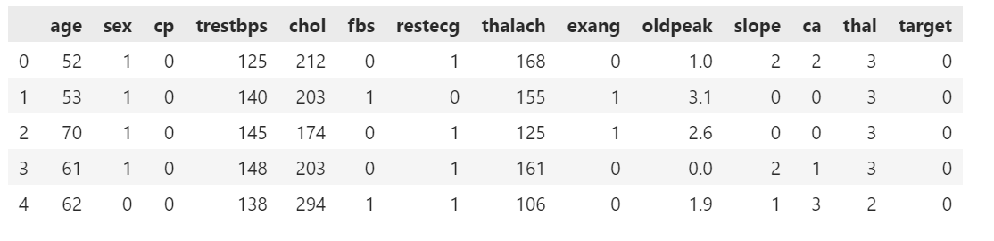
WHAT DOES THE DATA LOOK LIKE?
This data set dates from 1988 and consists of four databases: Cleveland, Hungary, Switzerland, and Long Beach V. It contains 76 attributes, including the predicted attribute, but all published experiments refer to using a subset of 14 of them. The "target" field refers to the presence of heart disease in the patient. It is integer valued 0 = no disease and 1 = disease.

Slide 5
Features used
age : Age of the individual.
Sex : Sex of the individual (usually 1 for male and 0 for female).
Cp : Chest pain type.
Trestbps : Resting blood pressure (in mm Hg on admission to the hospital).
Chol : Serum cholesterol in mg/dl.
Fbs : Fasting blood sugar > 120 mg/dl (1 = true; 0 = false).
Restecg : Resting electrocardiographic results.
Thalach : Maximum heart rate achieved.
Exang : Exercise-induced angina (1 = yes; 0 = no).
Oldpeak : ST depression induced by exercise relative to rest.
Slope : The slope of the peak exercise ST segment.
Ca : Number of major vessels (0-3) colored by fluoroscopy.
Thal : Thalassemia (a blood disorder).
Target : Heart disease (1 = yes; 0 = no).

Slide 6
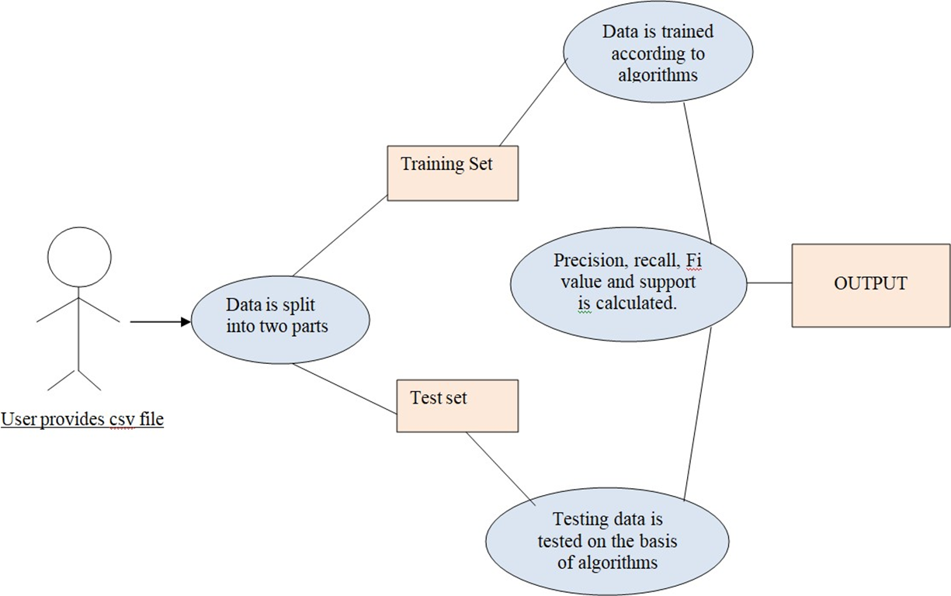
PROJECT FLOW
Algorithms Used
KNN
Naïve Bayes
K means
Support Vector Machine
Decision Tree
Logistic Regression
Random Forest
7

Slide 7
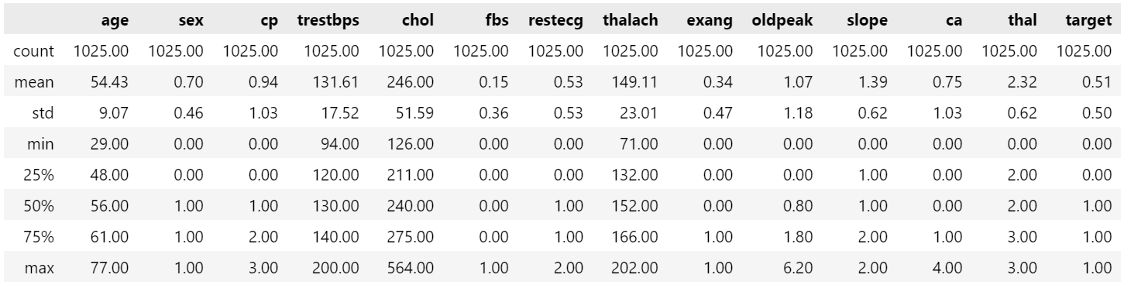
PRIMARY STATISTICS
Statistics include count, mean, standard deviation, minimum, 25th percentile (Q1), median (50th percentile), 75th percentile (Q3), and maximum values for each column

Slide 8
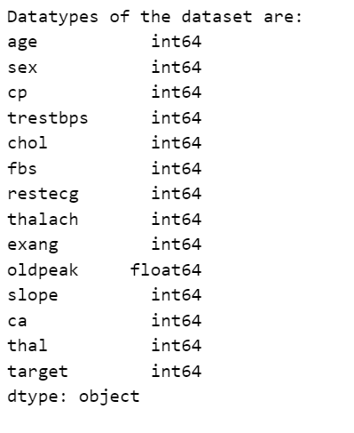
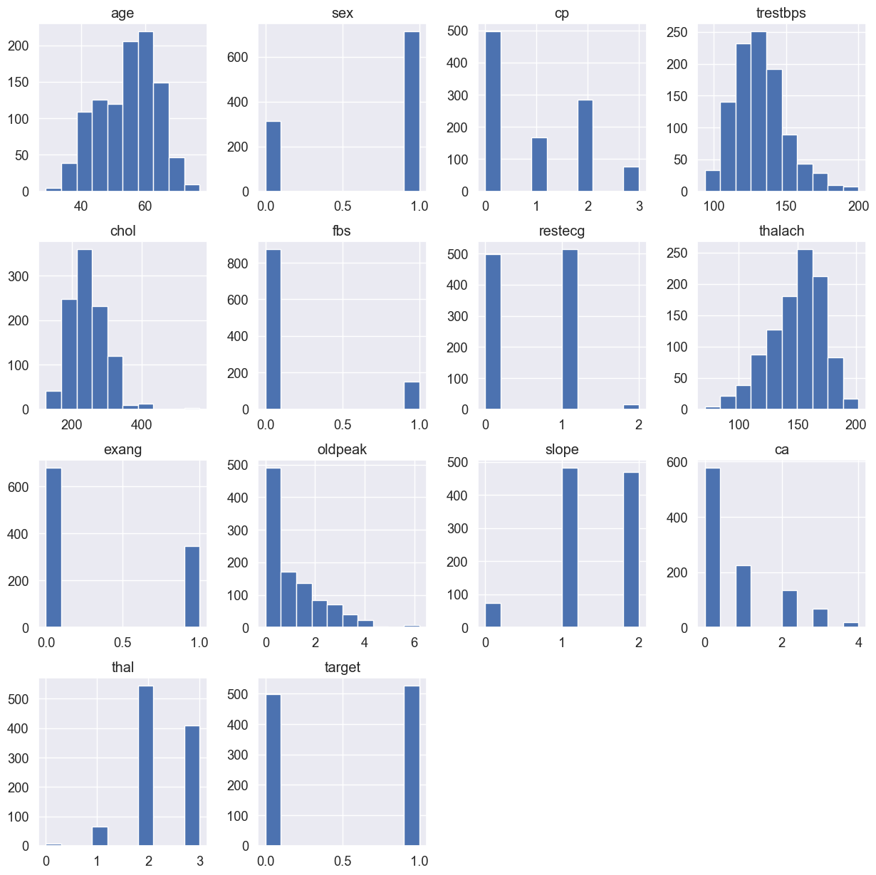
Type and DISTRIBUTION OF THE VARIABLES

Slide 9
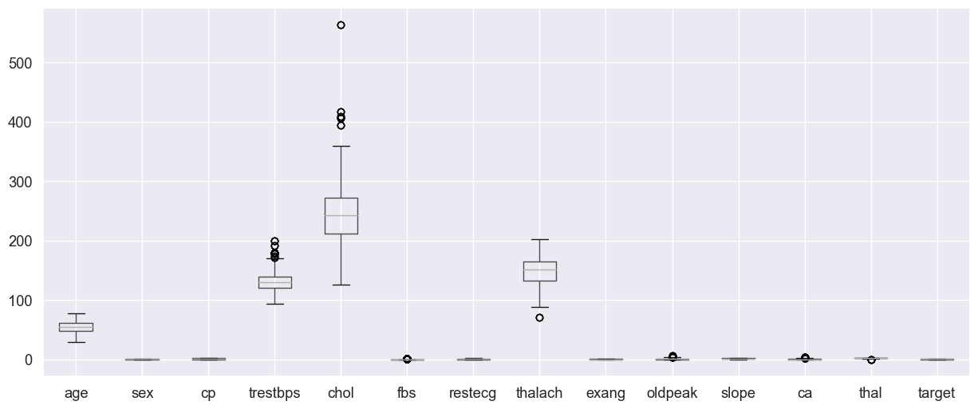
Detecting outliers using boxplots

Slide 10
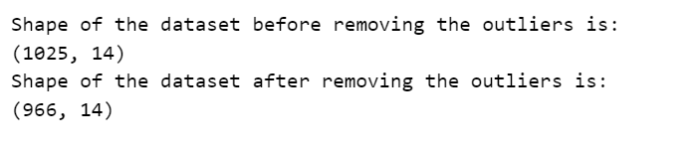
preprocessing
Checked for any missing values using isnull( ) method
Random missing values are introduced by generating a random number between 0 and 75 for each column
Replaced the missing values with the average of each column. The mean was calculated using the fillna( ) method
Boxplots were created to visually identify the outliers
Removed the outliers using IQR method
The shape of the dataset is printed before and after removing the outliers below:

Slide 11
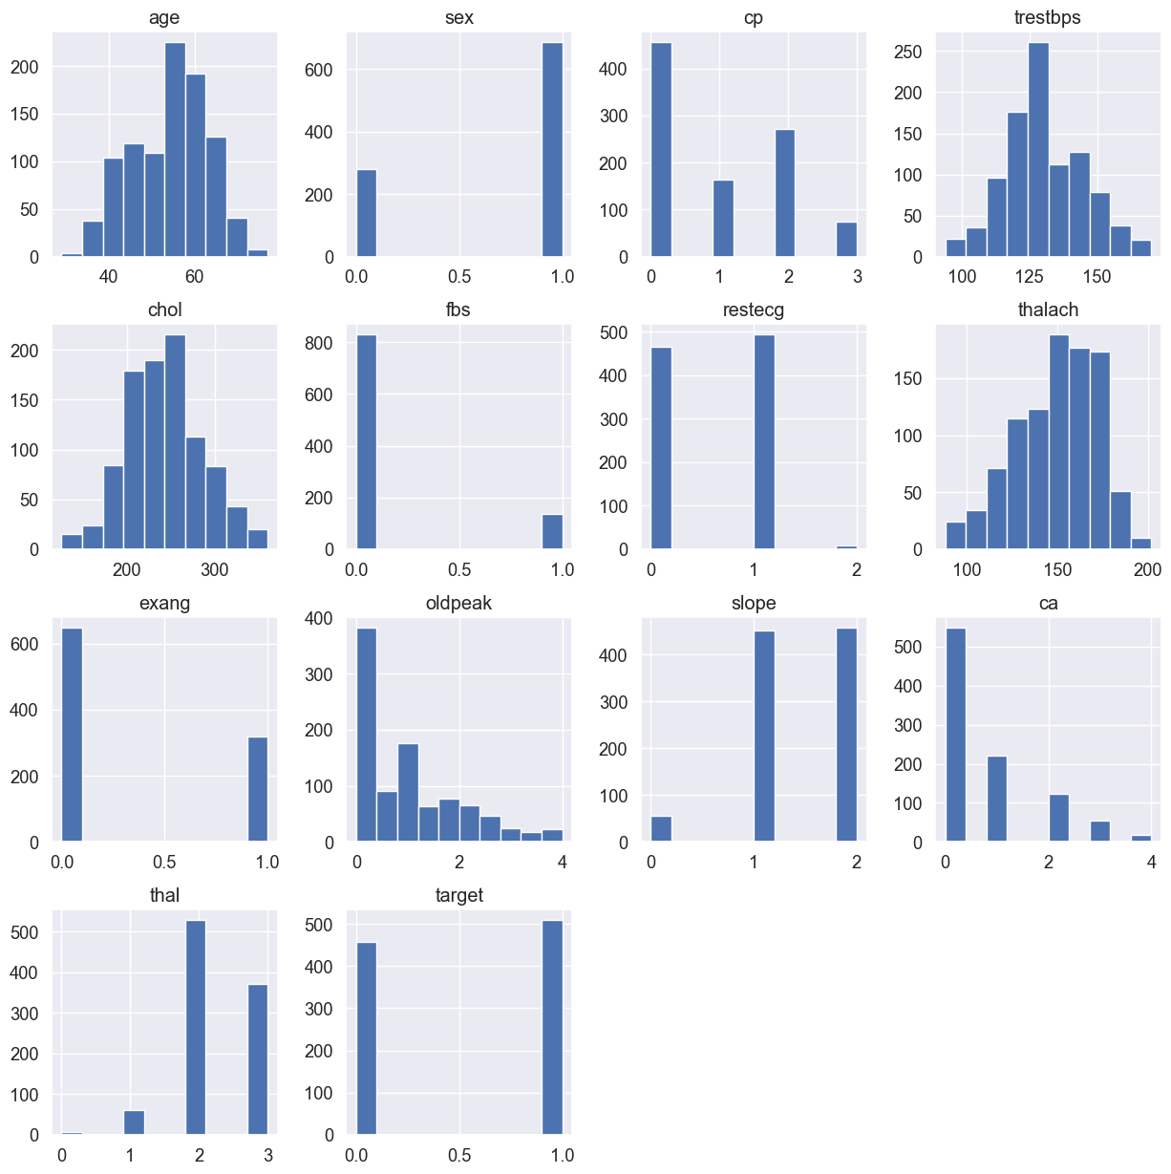
Distribution of variables after preprocessing

Slide 12
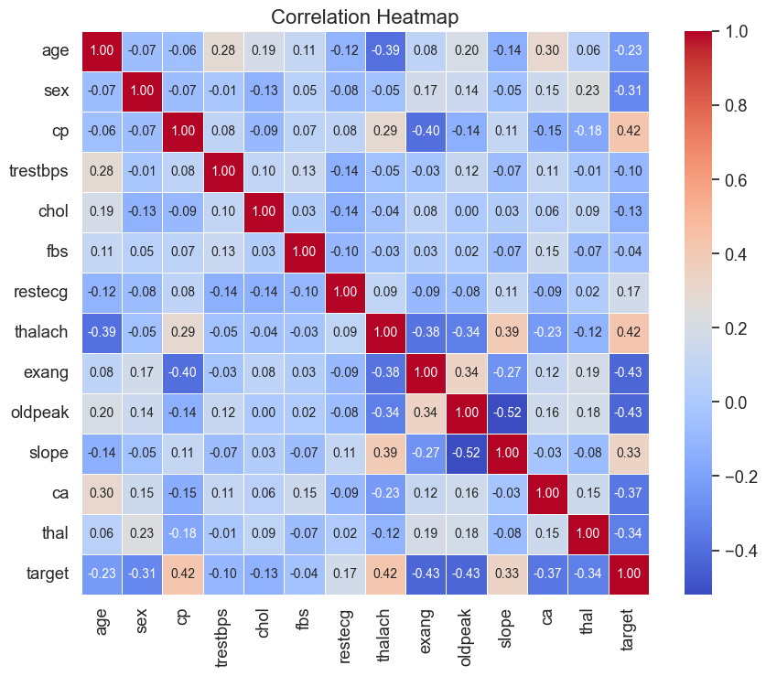
Correlation coefficients

Slide 13
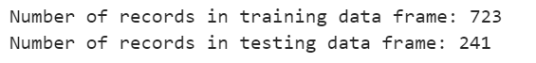
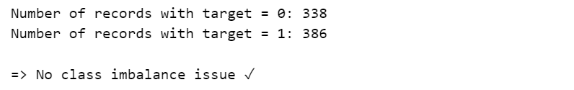
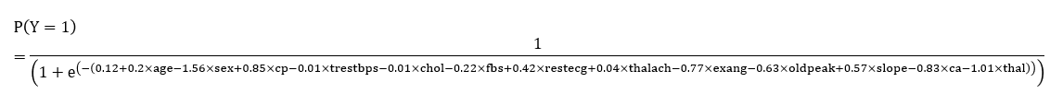
1. Model: logistic regression
Step 1: Divide the dataset into two sets; training (80% of records) and testing (20% of records) using 42 as a random seed
Step 2: Verify whether there is a class imbalance issue in the target variable
Step 3: The obtained formula for the prediction

Slide 14
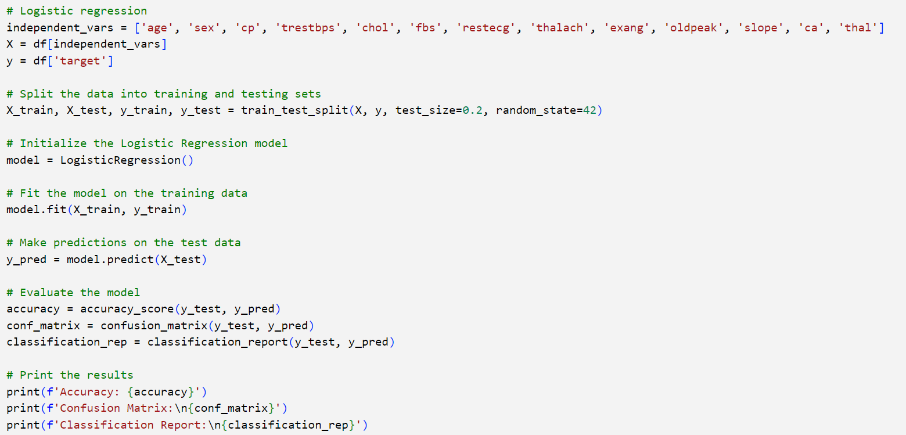
LOGISTIC REGRESSION Code :

Slide 15
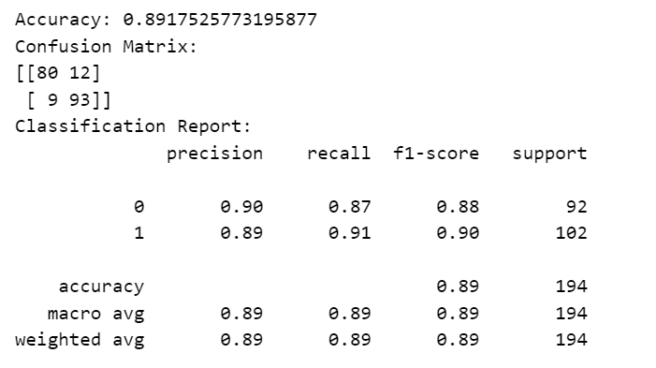
1. Model: logistic regression
Confusion matrix and the accuracy of the model:

Slide 16
2. MODEL K- Nearest neighbors (KNN) Algorithm
Step 1 :The independent variables for prediction are selected.
Step 2 : The data is split into training and testing sets using the train_test_split function. 80% of the data is used for training and 20 % is reserved for testing.
Step 3 : The KNN classifier is instantiated with specific parameters. n_neighbors = 5 : It considers 5 nearest neighbors for classification metric = ‘minkowski’ : The distance metric used p= 2 : corresponds to the Euclidean distance The classifier is then fitted to the standardized training data

Slide 17
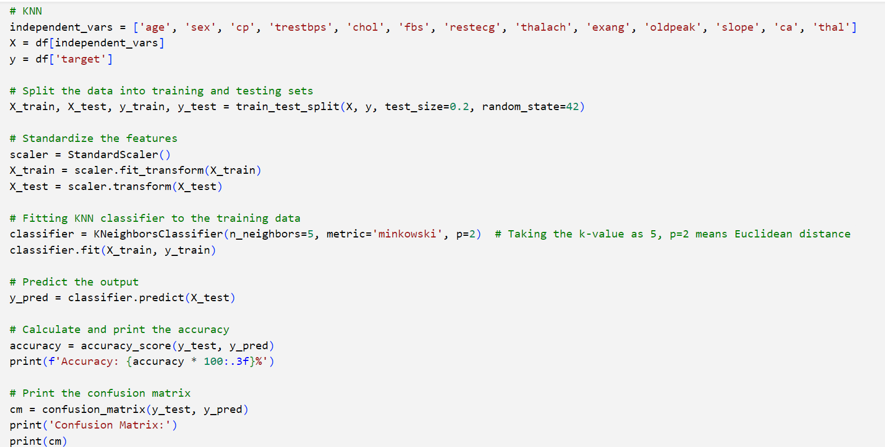
knn Code :

Slide 18
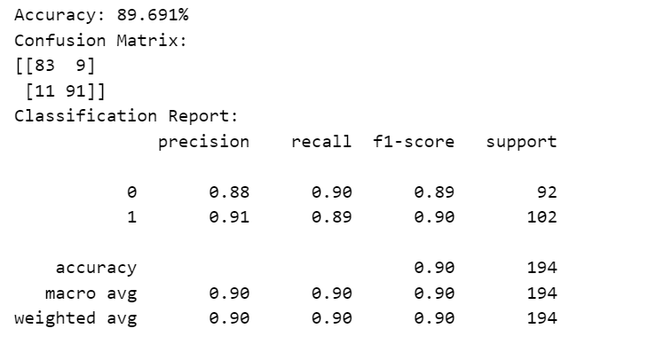
2. MODEL KNN
Confusion matrix and the accuracy of the model:

Slide 19
3. MODEL naïve Bayesian classifier (NBC) Algorithm
Step 1 :The independent variables for prediction are selected. These include attributes such as age, sex, cp, trestbps, chol, fbs, restecg, thalach, exang, slope, ca, and thal.
Step 2 : The data is split into training and testing sets using the train_test_split function. 80% of the data is used for training and 20 % is reserved for testing.
Step 3 : Features are standardized to ensure that each feature contributes equally to the model. The Gaussian Naive Bayes classifier is chosen for this dataset

Slide 20
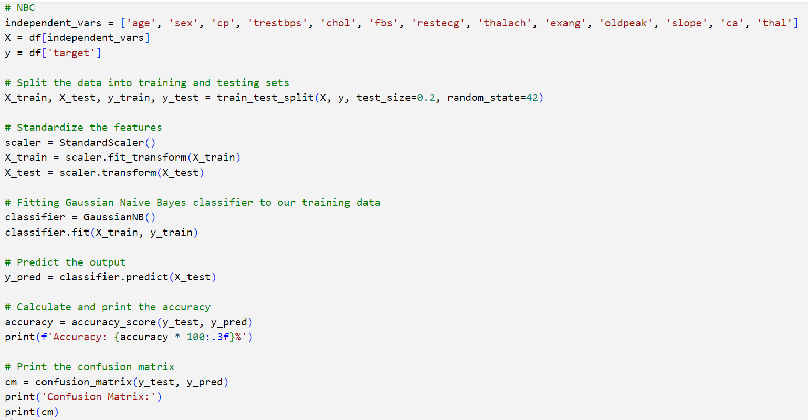
NBC Code :

Slide 21
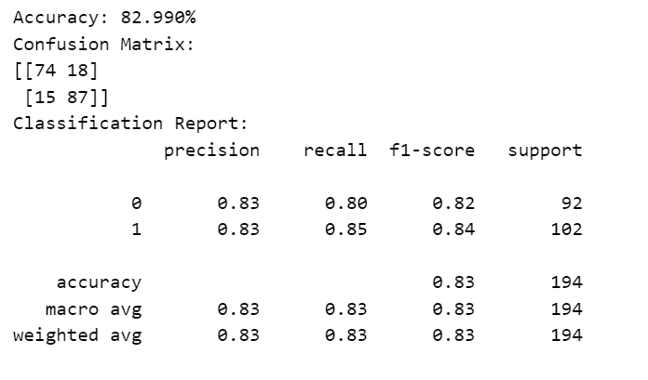
3. MODEL - NAÏVE BAYES CLASSIFICATION
Confusion matrix and the accuracy of the model:

Slide 22
4. MODEL - SUPPORT vector machines (SVM) Algorithm
Step 1 :The independent variables for prediction are selected. These include attributes such as age, sex, cp, trestbps, chol, fbs, restecg, thalach, exang, slope, ca, and thal.
Step 2 : The data is split into training and testing sets using the train_test_split function. 80% of the data is used for training and 20 % is reserved for testing.
Step 3 : Features are standardized to ensure that each feature contributes equally to the model. The SVM classifier is instantiated with a linear kernel using ‘kernel’ = ‘linear’. The classifier is fitted to the standardized training data using the fit () method.

Slide 23
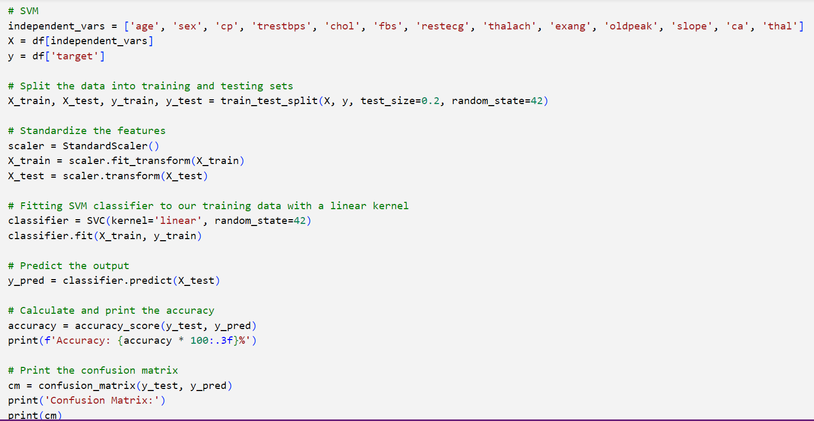
SVM Code :

Slide 24
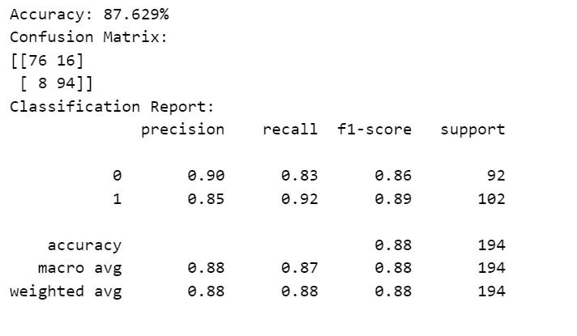
4. MODEL - SVM
Confusion matrix and the accuracy of the model:

Slide 25
5. MODEL – decision tree Algorithm
Step 1 :The independent variables for prediction are selected. These include attributes such as age, sex, cp, trestbps, chol, fbs, restecg, thalach, exang, slope, ca, and thal.
Step 2 : The data is split into training and testing sets using the train_test_split function. 80% of the data is used for training and 20 % is reserved for testing.
Step 3 : The Decision Tree classifier is instantiated with a specified criterion for splitting nodes criterion = ‘gini’ : The Gini impurity is used as the criterion for splitting nodes. The classifier is fitted to the training data using the fit () method.

Slide 26
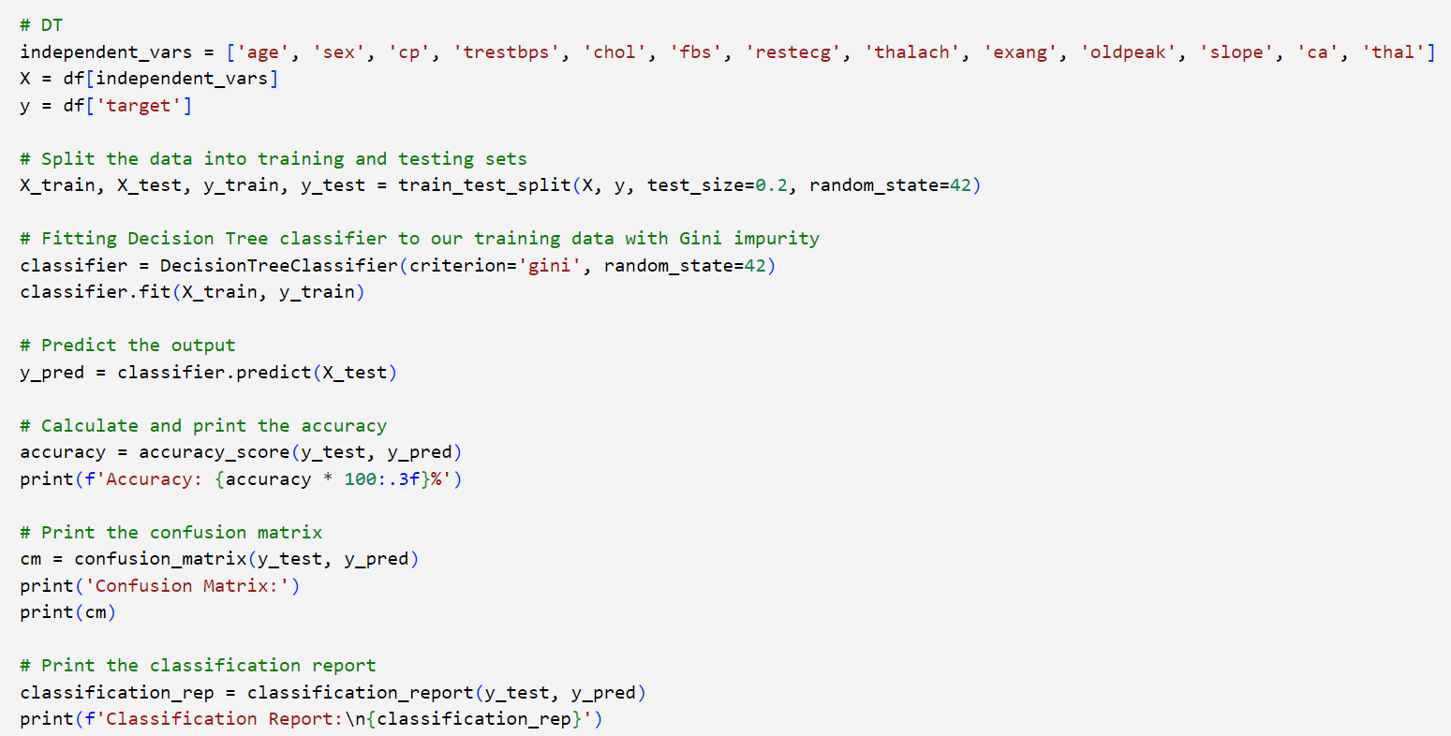
5. Model - decision tree

Slide 27
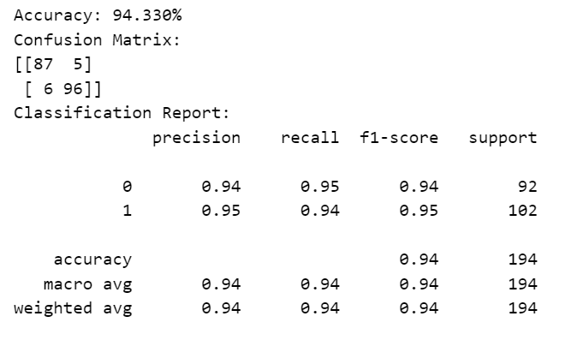
5. MODEL – decision tree
Confusion matrix and the accuracy of the model:

Slide 28
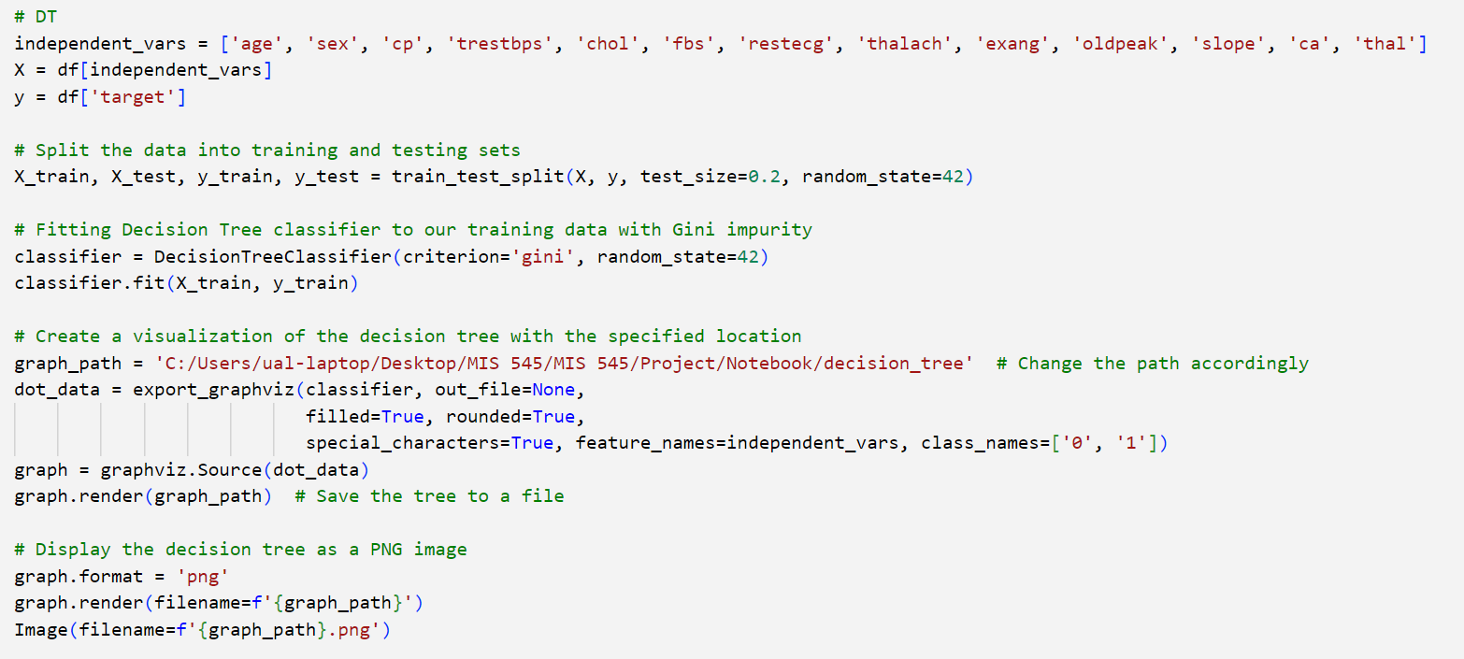
5. Model - decision tree Visualizing the algorithm

Slide 29
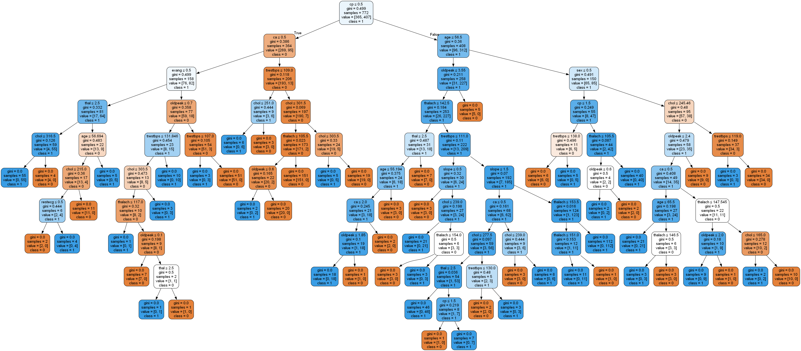

Slide 30
6. MODEL – random forest Algorithm
Step 1 :The independent variables for prediction are selected. These include attributes such as age, sex, cp, trestbps, chol, fbs, restecg, thalach, exang, slope, ca, and thal.
Step 2 : The data is split into training and testing sets using the train_test_split function. 80% of the data is used for training and 20 % is reserved for testing.
Step 3 : The Random Forest classifier is instantiated with specific parameters n_estimators = 100 : the number of trees in the forest criterion = ‘gini’ : the function to measure the quality of a split

Slide 31
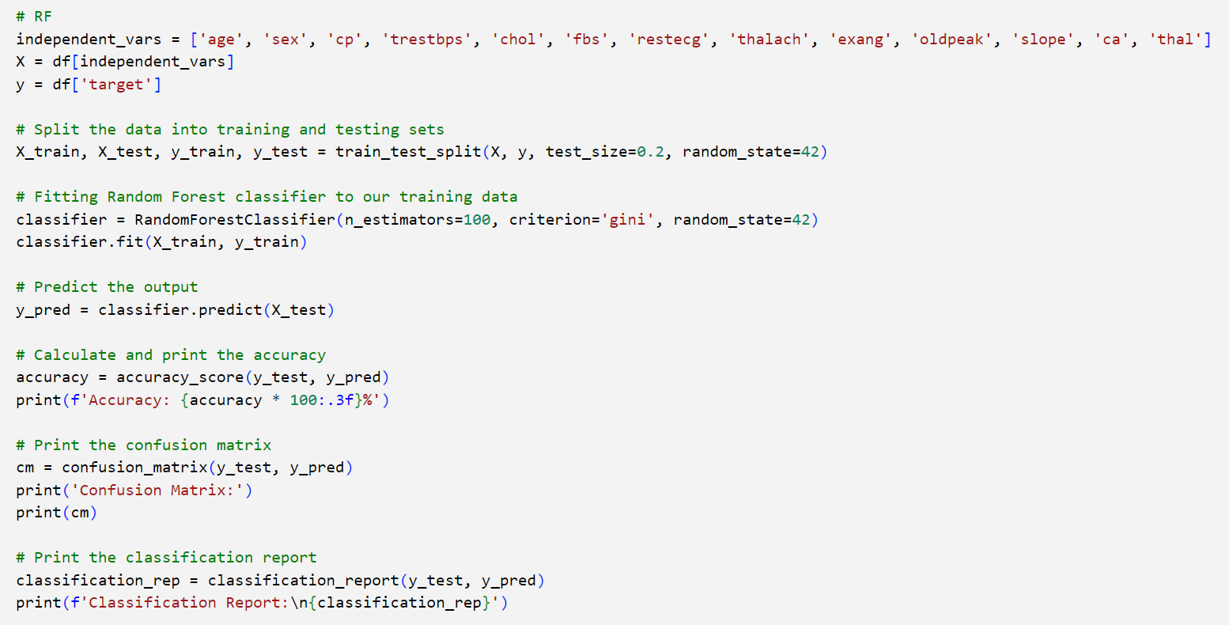
6. MODEL – RANDOM FOREST code

Slide 32
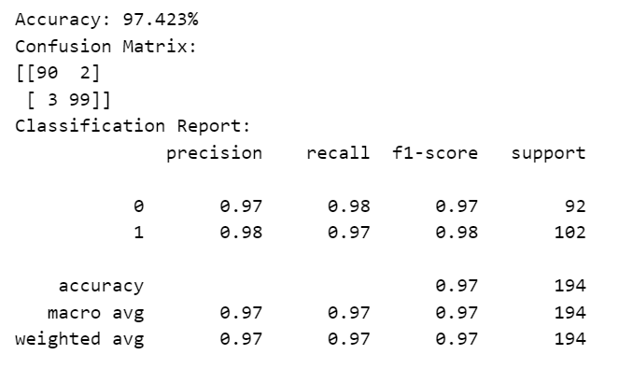
6. MODEL – RANDOM FOREST
Confusion matrix and the accuracy of the model:

Slide 33
7. MODEL – K MEANS
Step 1 : The parameter ‘n_clusters’ is set to 3, indicating the desired number of clusters in the data
Step 2 : The K-Means model is fitted to the data using the fit () method. Cluster assignments for each data point are obtained using the ‘labels’ function
Step 3 : The cluster centers (centroids) are accessed using the ‘cluster_centers’ attribute. Lower inertia values indicate more compact clusters

Slide 34
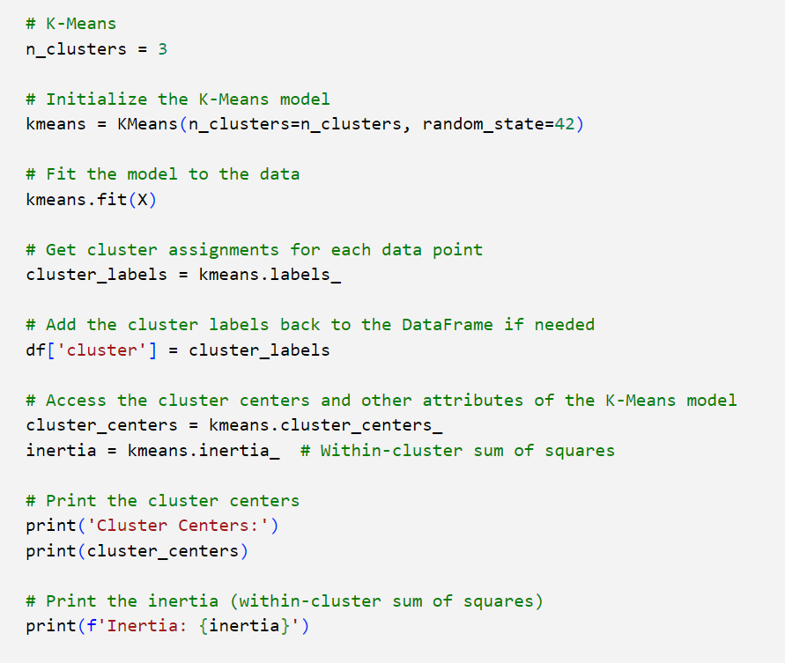
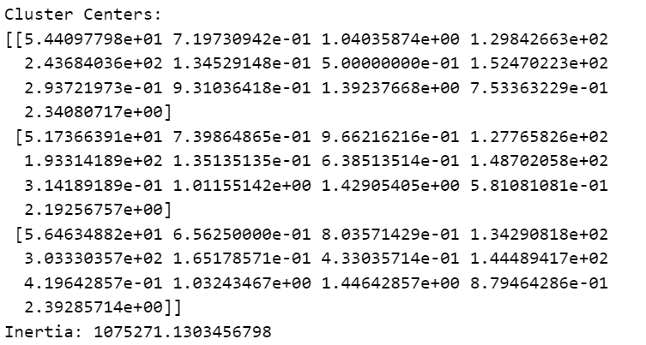
7. MODEL – K MEANS code

Slide 35
7. MODEL – K MEANS
K-means is primarily designed for numerical, continuous data. The algorithm calculates means and assigns data points to clusters based on the Euclidean distance between points and cluster centers. Therefore, when working with categorical data, which consists of non-numeric values and lacks a meaningful distance metric, traditional K-means is not directly applicable.

Slide 36
PERFORMANCE METRICS :
Model | Accuracy | Precision | Recall | F1 Score | Support
Logistic Regression | 89.17% | 0.89 | 0.89 | 0.89 | 194
KNN | 89.69% | 0.90 | 0.90 | 0.90 | 194
Naïve Bayes | 82.99% | 0.83 | 0.83 | 0.83 | 194
SVM | 87.62% | 0.88 | 0.88 | 0.88 | 194
Decision Tree | 94.33% | 0.94 | 0.94 | 0.94 | 194
Random Forest | 97.42% | 0.97 | 0.97 | 0.97 | 194

Slide 37
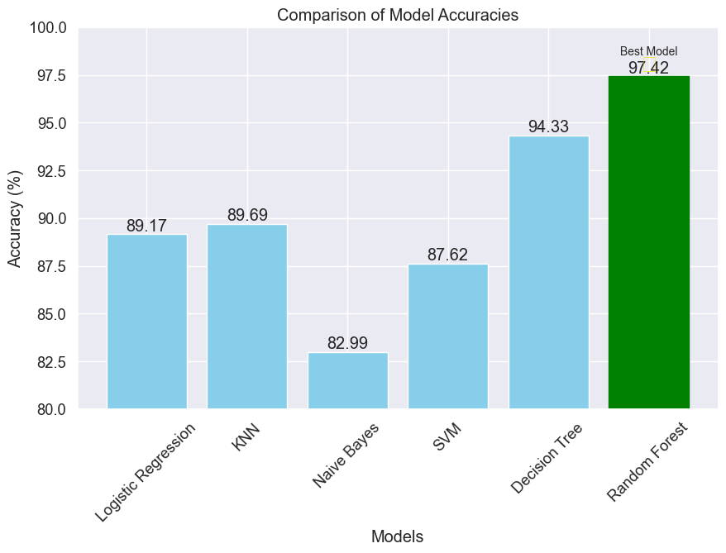
Comparison of model accuracies

Slide 38
HYPOTHESIS CONCLUSION
The multivariate analysis conducted on the dataset provided strong evidence supporting the hypothesis that a combination of all the attributes serve as a robust predictor for the presence or absence of heart disease in the studied population. The significance of individual attributes and their interactions were thoroughly examined, providing valuable insights into the complex relationship between these factors and the occurrence of heart disease.

Slide 39

Thank you

